Slide 1

DriverPass System Analysis
Cheyenne Nave
April 21st, 2024
Notes:
[No speaker notes required for this slide.]

Slide 2

System Requirements
Functional Requirements
User-login
Reservation Scheduling
Nonfunctional Requirements
Performance
Scalability
Notes:
User-login is a functional requirement for the DriverPass system. This allows the student or employee to log in to the program and access the varying modules. Reservation Scheduling is a functional requirement that will allow students and employees(secretaries) to schedule a drive with the DriverPass drivers. Performance is a nonfunctional requirement that is needed to make the program run efficiently. This includes a response time of less than 3 seconds. The program needs to be scalable, so as the program grows, it can handle more users.

Slide 3
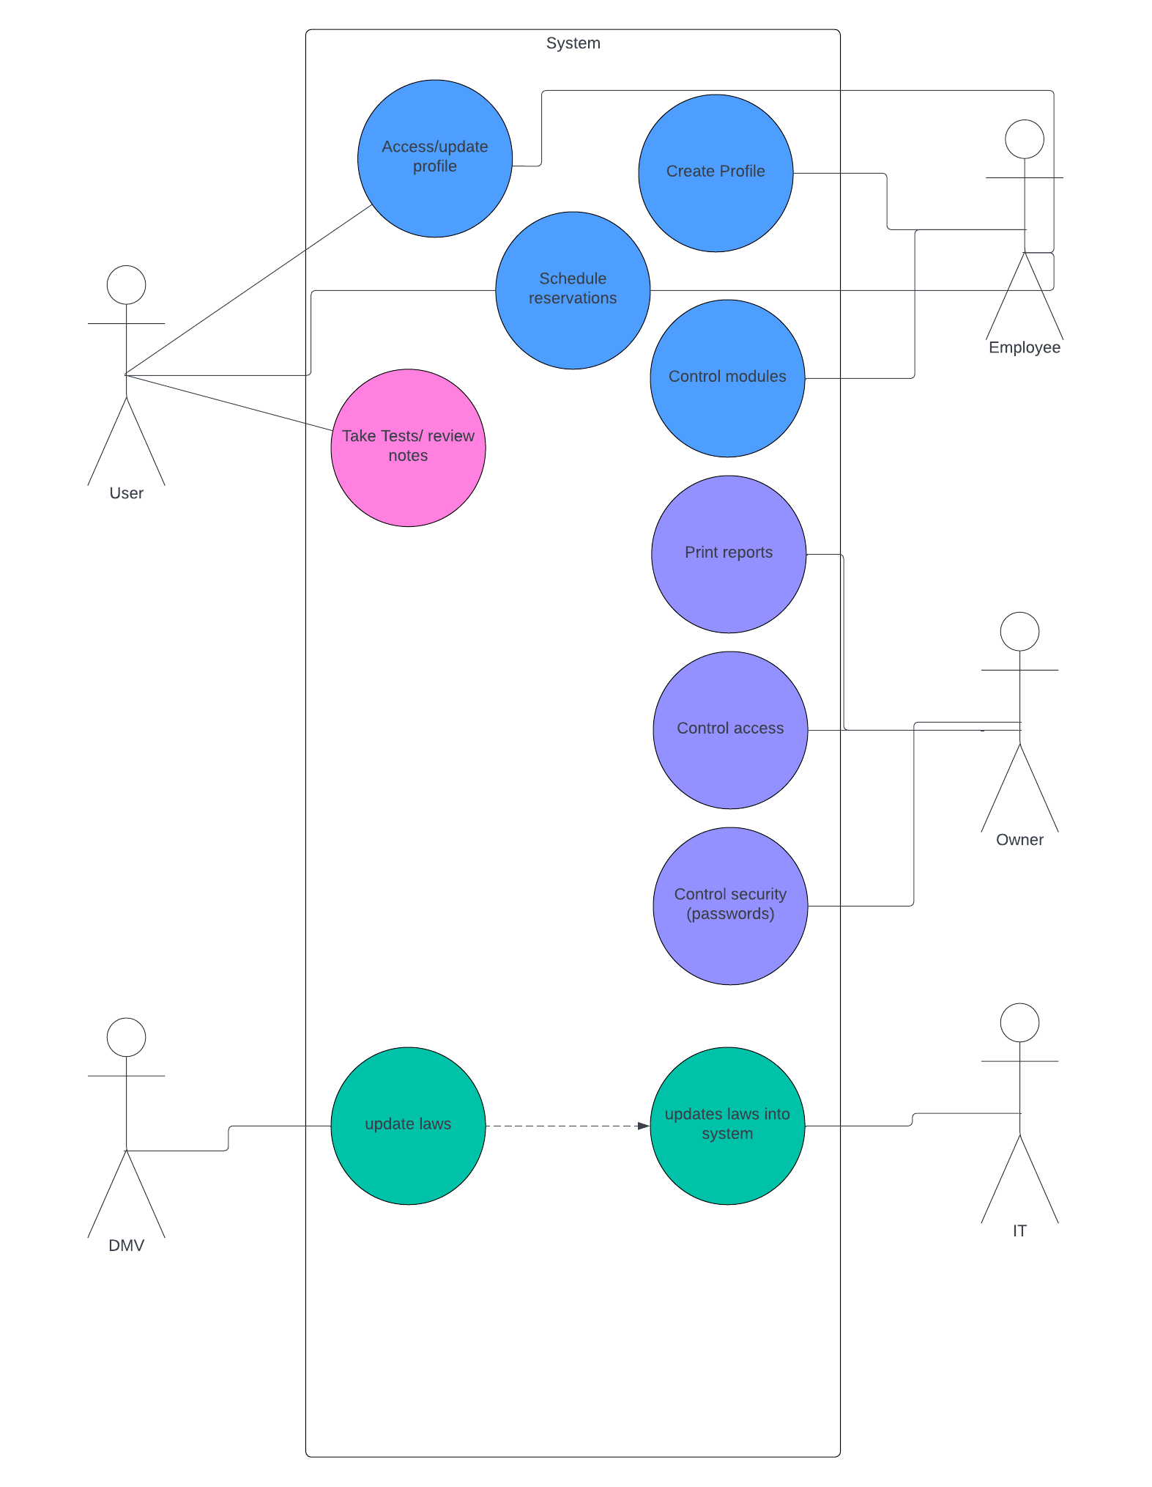
Use Case Diagram
Notes:
Here we can see that the user(student), DMV, Employee, Owner, and IT specialist will have access to the program. The user can update their profile, take tests, and schedule reservations. The Employee can create profiles, schedule reservations and control the visibility of modules. The Owner can print reports, control access, and control security. The DMV provides updates to traffic laws and IT will add the updates.

Slide 4
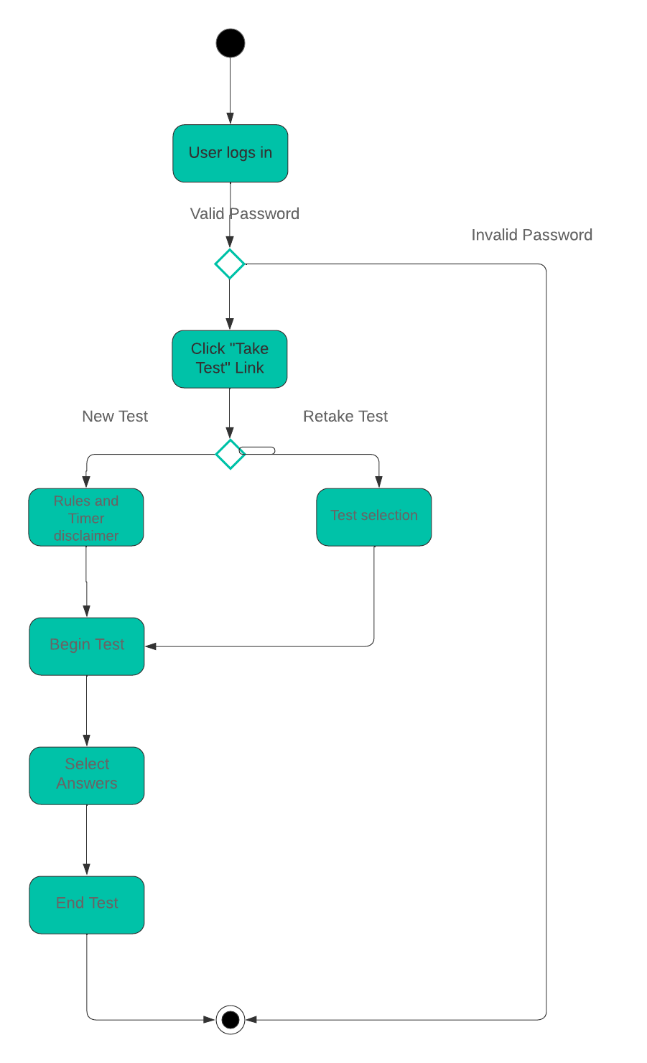
Activity Diagram
Notes:
This diagram explains how the Test-Taking module will work. The student will log in to the system with a valid password, then they will click a link labeled “Take Tests”. They will be given an option to either take a new test or retake an old test. If they take a new test, a disclaimer will pop up stating the rules (no other tabs open, etc.) and allotted time, then they will begin the test. If they choose to retake an old test, they will be taken to a screen to choose which test shall be retaken, then the test will begin. The student will select their answers and then end the test once submitted. If the password is invalid, the student is taken back to the login page. This design is simple and efficient for the user’s of DriverPass’s program because it provides a streamlined experience.

Slide 5
Security
Multifactor Authentication
Employees
Students
Owner
IT
Encrypted Chat
Notes:
All users of the DriverPass system will be required to set up multifactor authentication with two of the following: email, phone, fingerprint ID, faceID, security code. This will strengthen the security and prevent cyber attacks from information theft. Also, all chats between Students and Employees will be encrypted so location pickups, drop-offs, notes, etc. will be secure. This will prevent a hacker from identifying our students’ and employees’ physical locations as well as any other personal identifying information

Slide 6
System Limitations
Processing Power
Insufficient Memory
Insufficient Storage
Notes:
If a student has an older computer, the processing power may be slower, providing the student with a much slower experience with the program. Also, if a student has other applications on their phone or computer that take up a lot of space, the program may not be able to run. Finally, a user may not have enough physical storage for the program and may have to delete items from their phone or computer to use DriverPass’ new technology.

